Slide 1
Opswise DCM BPO V7.2 Automation Project: 2020 Process Improvement Summary Results
Chris Amendola
June 9th 2020
Notes:
So I thought I would take a few minutes and do a semi-formal follow-up on the 2020 Process Improvement Project around Opswise Automation for the DCM 7.2 and beyond data pipeline.
The main objective of this project, as you all may remember, was to take advantage of efforts made in 2019, the results of which enabled Data Factory (DA) to be able to deliver Performance Engine (PE) ready data submissions to Impact Implementations.

Slide 2
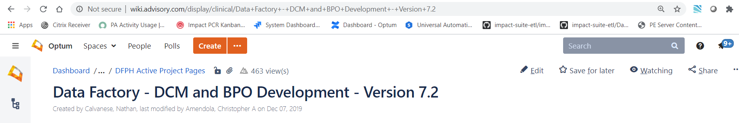
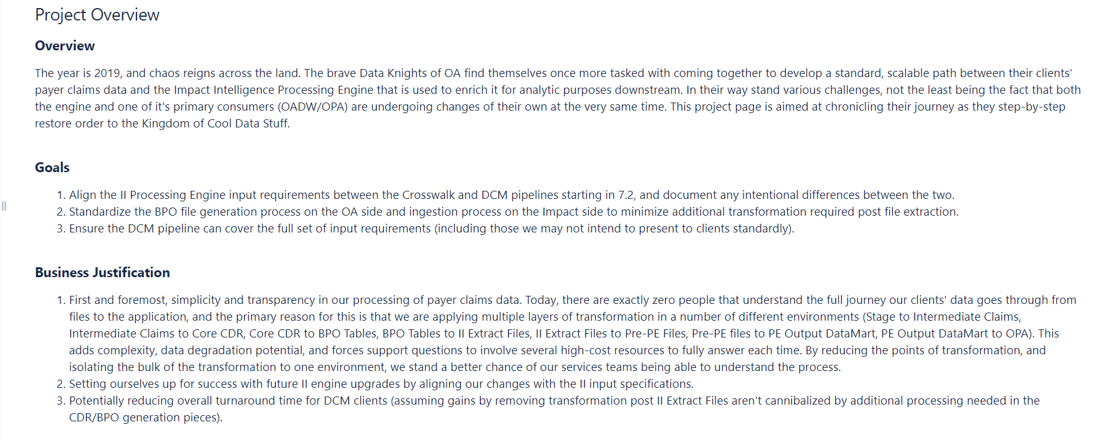
Prolog: Data Factory - DCM and BPO Development (2019)
Notes:
Project Page from the wiki

Slide 3
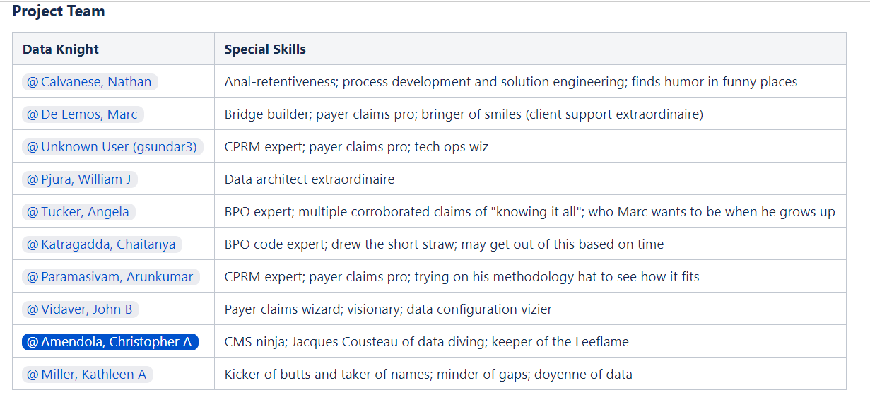
Prolog: Data Factory - DCM and BPO Development (2019)
Notes:
Here’s the cross department team involved.
***
Since PE-ready files represent a standard specification for every data submission no ETL support would be required on the part of the II team. PE-ready data could automatically be submitted to the II PE without user intervention, and in a much less complex, ‘Leaned-out’, workflow.

Slide 4
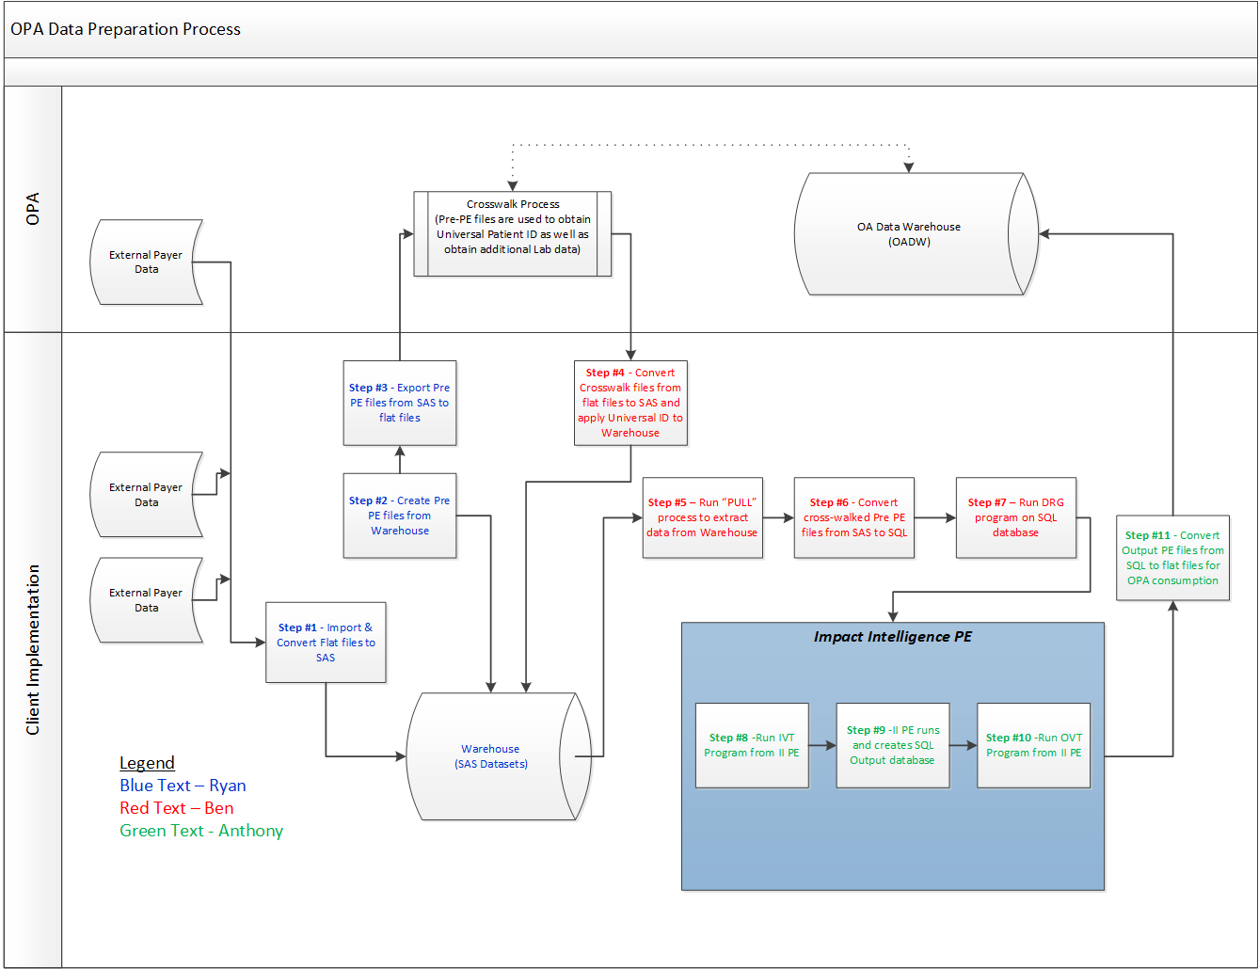
Work-Stream: OPA Data Preparation(Original/’Crosswalk’)
Notes:
To give you some idea of the complexity reduction - this is the original Work-Stream for OPA/Crosswalk clients.

Slide 5
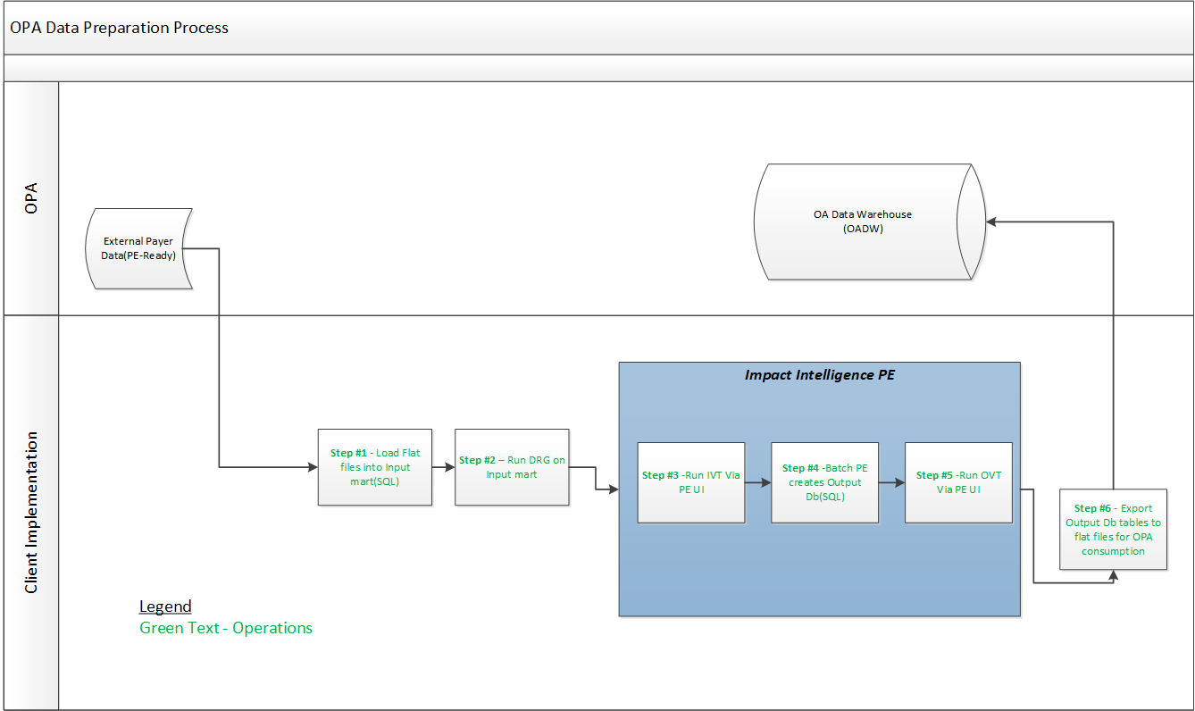
Work-Stream: OPA Data Preparation(DCM 7.2++)
Notes:
This is the DCM OPA Workstream that has been realized.
The systems development work for this project, this workflow, has been completed at this time, we are now in the process of deploying OPA DCM clients, coinciding with the OPA migration to the 7.2 version of II.

Slide 6
Key Results
Notes:
So given this is going on, I now want to quickly highlight the Key results, and some bonuses realized from this project

Slide 7
Significant reduction in complexity of the OPA data preparation process for DCM
Notes:
Seen this already

Slide 8
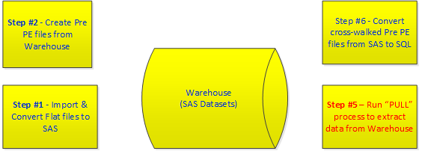
No ETL support required by Impact Implementations for OPA DCM Clients (Those steps no longer occur)
Notes:
Eliminated steps with ETL development required.

Slide 9
Significantly increased automation of the process (Beyond Opswise)
Built-in, just-in-time process validation steps
File Manifest Checking
Schema/Structural Validation of files in real time
Control Total Matching
Detects completeness of file-set, and un-expected files
Messages missing files
Messages on un-expected files
Process halts on either case
Validates input data against table constraints
Messages and reports on field/structural problems
Process halts upon any invalid data
Loaded row counts match raw file submission counts
Messages on row count mis-matches
Process halts upon mis-match

Slide 10
Additional Benefits
Results of Lean-ing out the process

Slide 11
Beneficial Side-Effects
Significant reduction in the LOE for the transition of clients from implementation to operations
Client process is automation ready Day One
The current solution is general case
Supports any hosted client (not only DCM) with PE ready files
Modest reduction in over-all runtime, and disk resources
The elimination of Intake and Warehouse steps from process
(Measured Estimates TBD)
Notes:
***

Slide 13
Christopher Amendola
Thank you slide
Title
Contact information

